Slide 1
MARKETING ANALYTICS I
SESSION 7:
MARKET SEGMENTATION
Professor Sonnier
Texas MSBA Program
Fall 2022

Slide 2
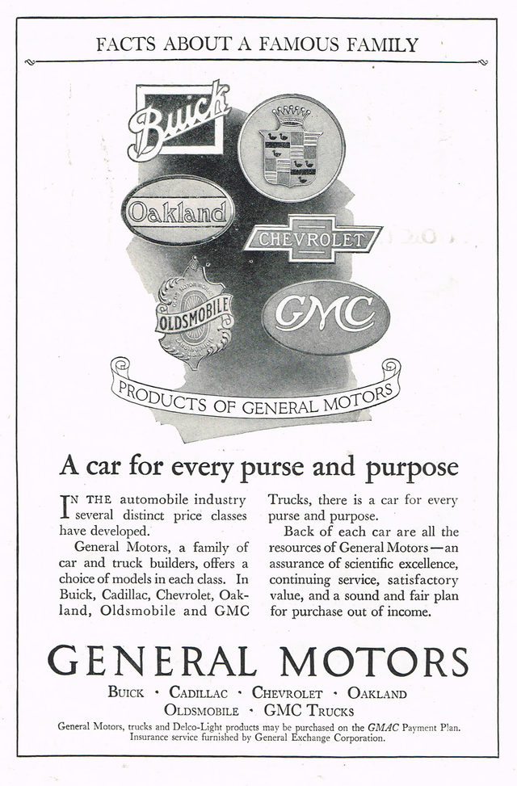
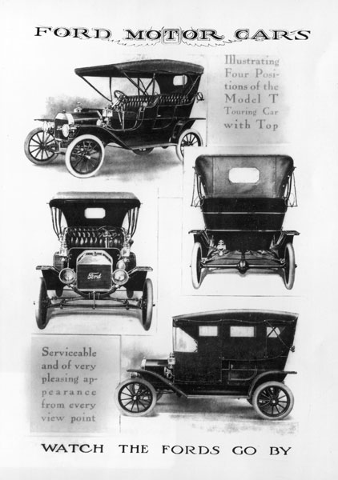
SEGMENTATION
Competitive Strategy in the Automotive Industry

Slide 3
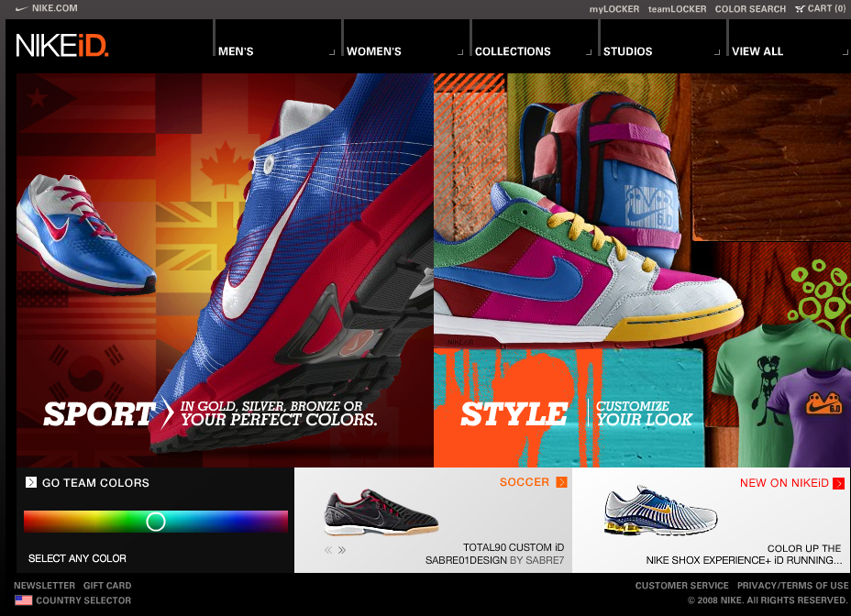
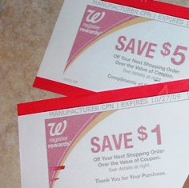
SEGMENTATION
Personalization: A Segment of One!
Personalized Products
Personalized Pricing

Slide 4
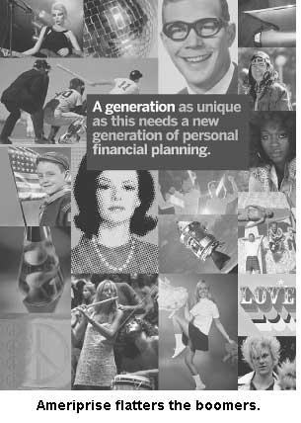
SEGMENTATION
Demography

Slide 5

SEGMENTATION
Demography

Slide 6
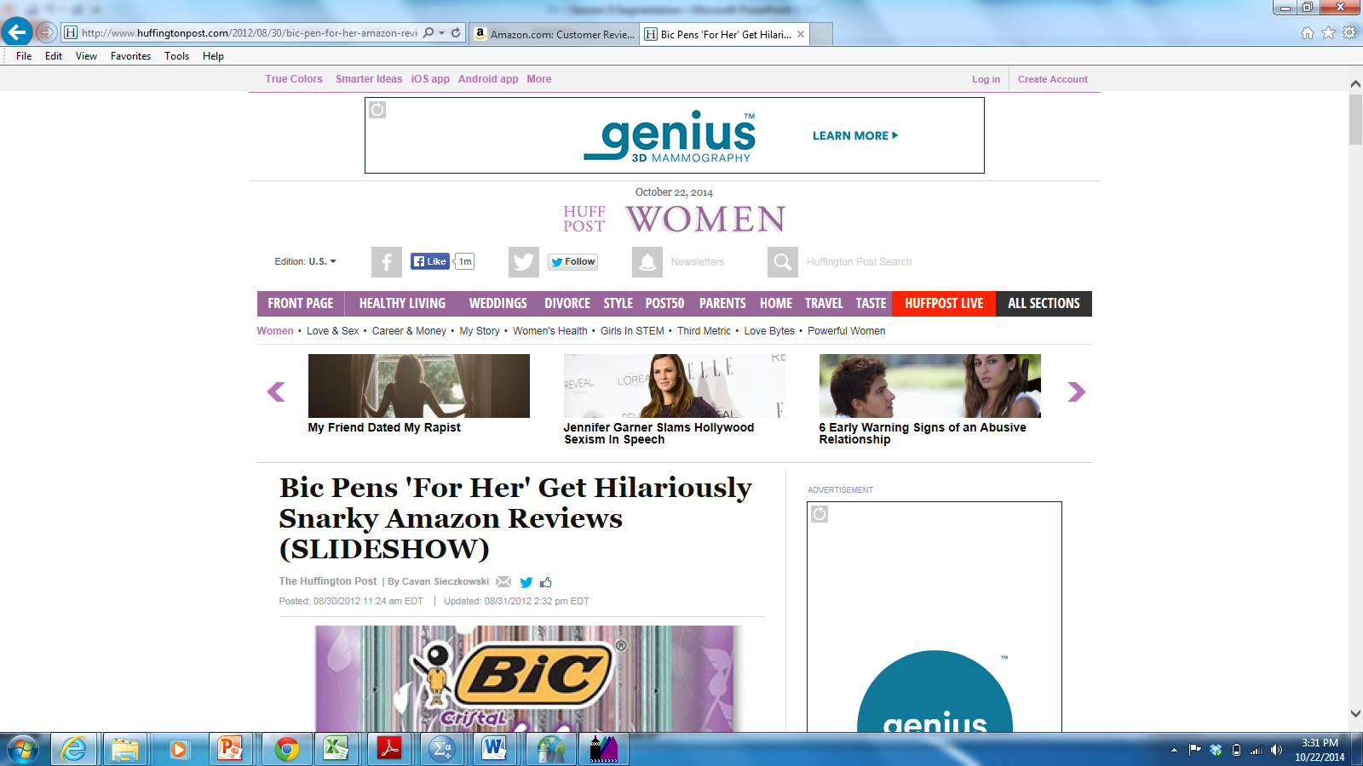
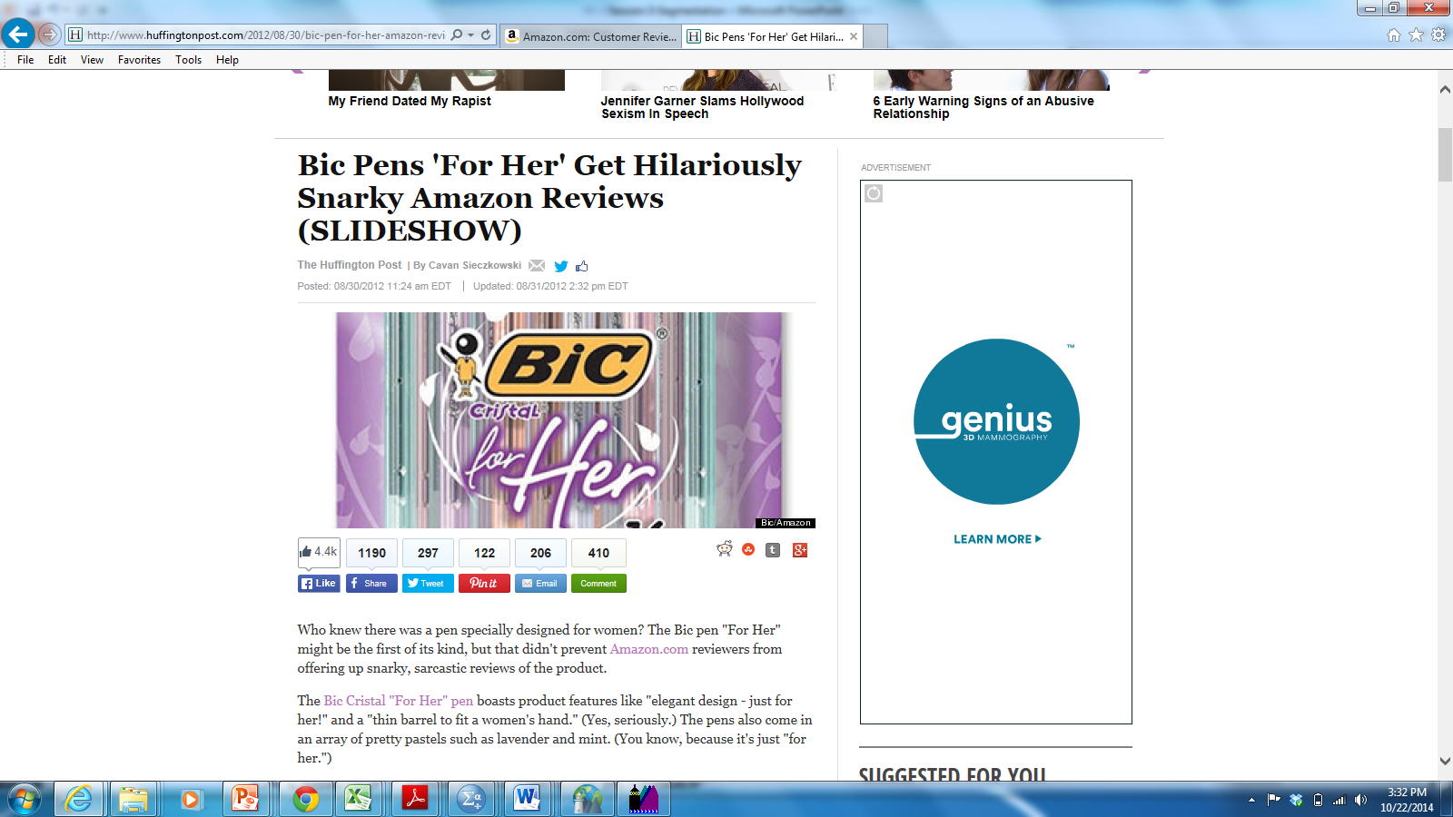
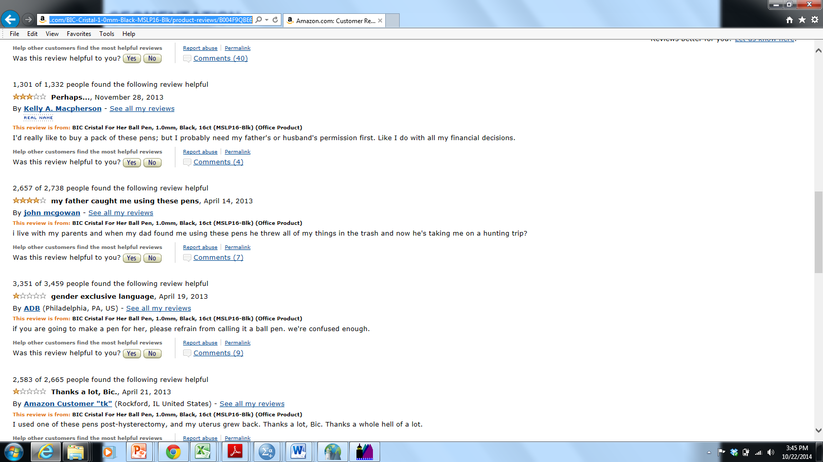
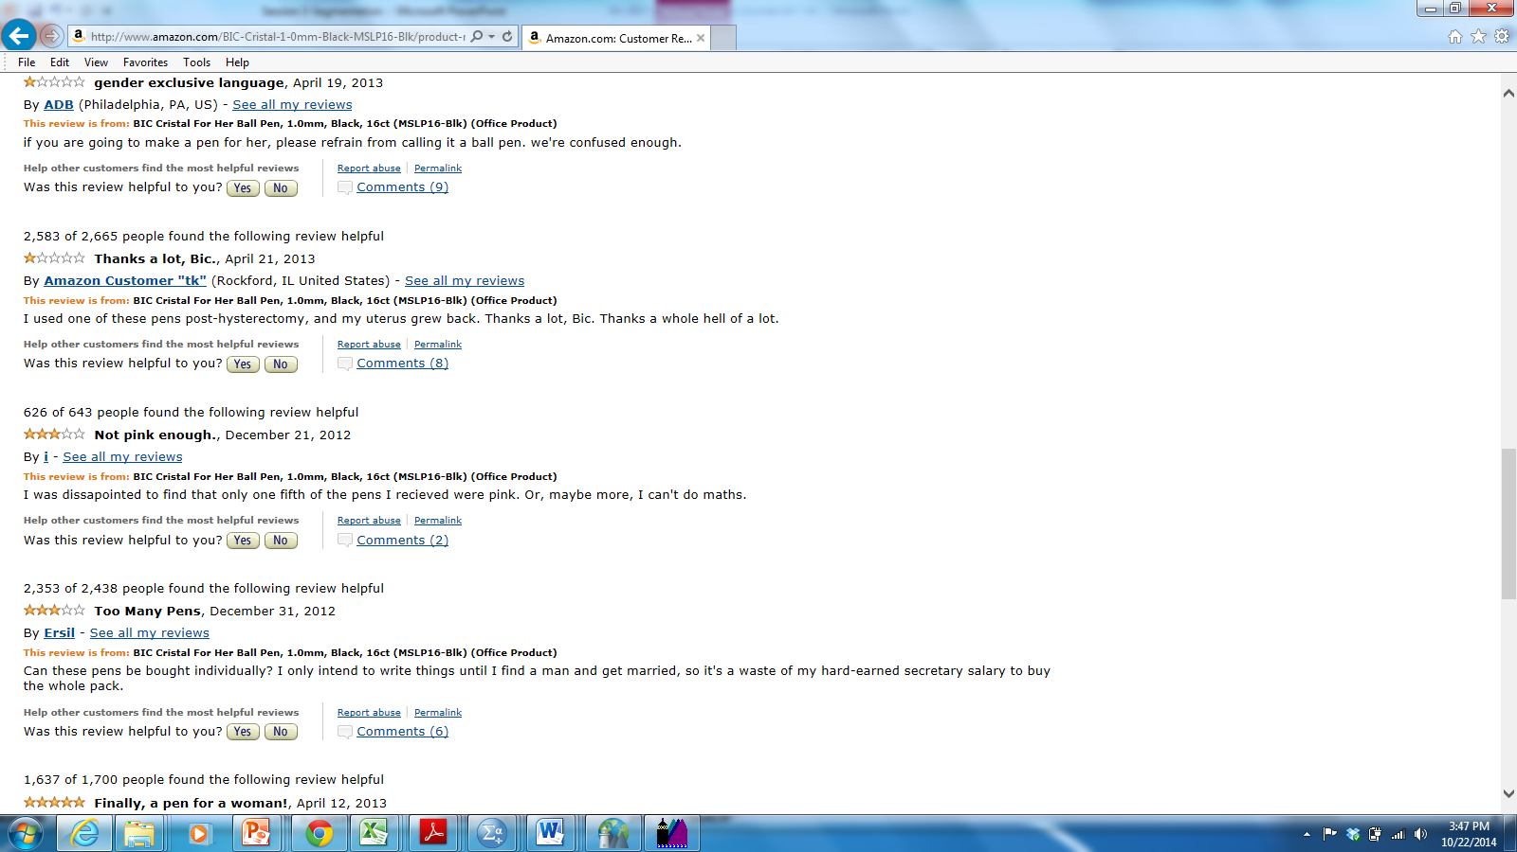
SEGMENTATION
Segmentation Meets Social Media…Hilarity Ensues

Slide 7
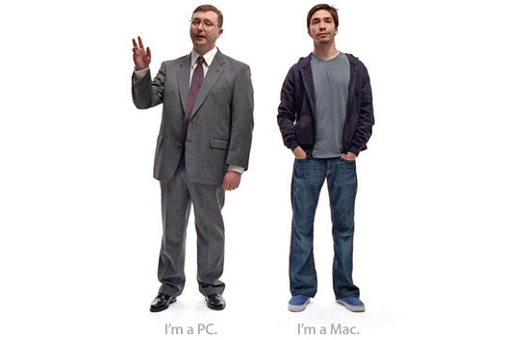
SEGMENTATION
PC vs. Mac

Slide 8
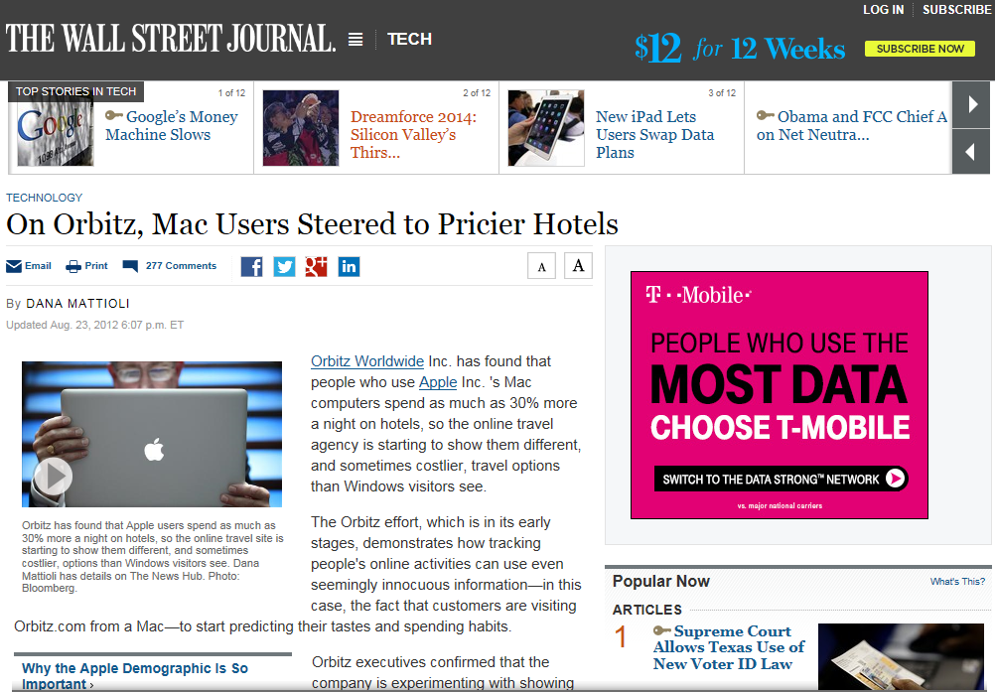
SEGMENTATION
Usage Segmentation: Mac vs. PC
http://online.wsj.com/articles/SB10001424052702304458604577488822667325882

Slide 9
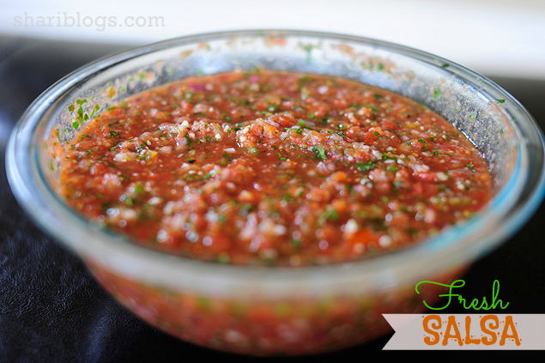
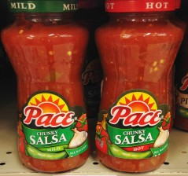
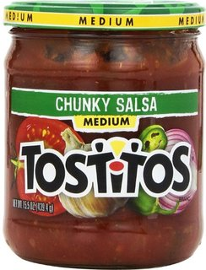
SEGMENTATION
Fresh Salsa is the Best

Slide 10
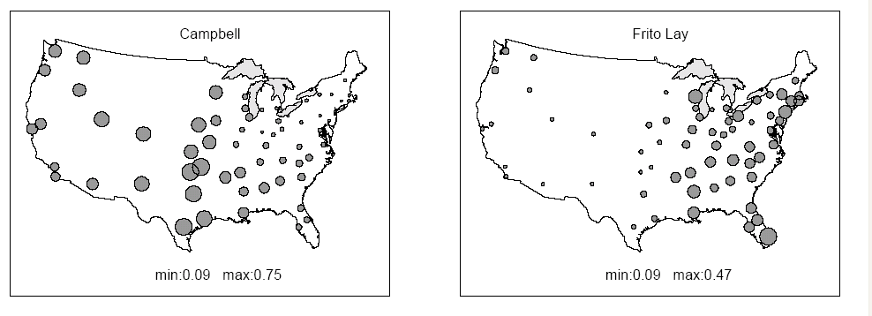
SEGMENTATION
Geographic Segmentation in CPG Markets

Slide 11
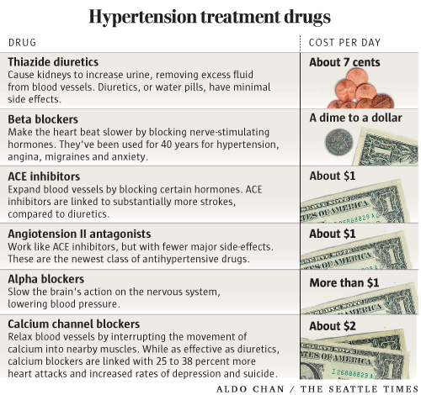

SEGMENTATION
Hypertension (aka High Blood Pressure)

Slide 12
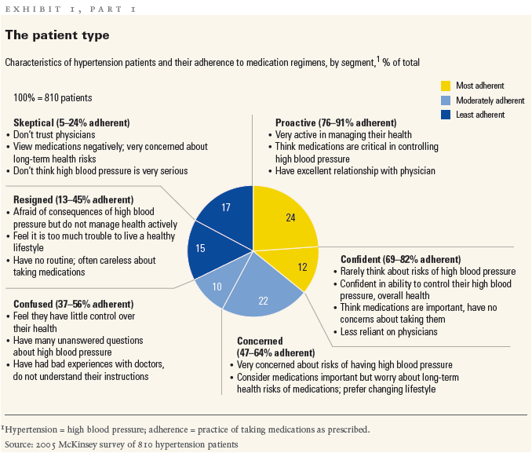
SEGMENTATION
Attitudinal Segmentation
Getting patients to take their medicine Jessica Hopfield, Robert M. Linden, and Bradley J. Tevelow. McKinsey Quarterly No 4. Dec 14, 2006

Slide 13
SEGMENTATION
Why Segment the Market?
Benefits to the Consumer
Benefits to the Firm
Finding market opportunities
Responding to customer heterogeneity
Improved resource allocation
Increased marketing efficiency
Tailored products and services
Relevant marketing offers
Personalized experience
Convenience and time savings
SUSTAINABLE GROWTH
VALUE TO THE CUSTOMER

Slide 14
SEGMENTATION
Success Factors
Differentiable
Substantial
Identifiable
Accessible
Actionable
Stable

Slide 15
SEGMENTATION, TARGETING, AND POSITIONING
The Basic Idea
Competitors
Target
S1
Position
Market
S2
S3
S4

Slide 16
SEGMENTATION
Bases for Segmentation
Segmentation Bases for Consumer Markets
Geographic | Country, State, Region
Demographic | Age, Gender, Occupation, Education
Psychographic | Lifestyle, Interests, Opinions
Behavioral | Usage, Frequency, Recency
Benefits Sought | Value, Quality, Prestige
Segmentation Bases for Business Markets
Geographic | Country, State, Region
Firmographic | Industry, Size, Public/Private
Buying Approach | Centralized, Team Based
Behavioral | Volume, Frequency, Risk Preference
Benefits Sought | Service, Quality, Price

Slide 17
SEGMENTATION
Bases for Segmentation
WHO
Who are the customers?
WHAT
What have the customers done?
WHY
Why do customers make the decisions they do?

Slide 18
SEGMENTATION
Bases for Segmentation
WHO
Who are the customers?

Slide 19
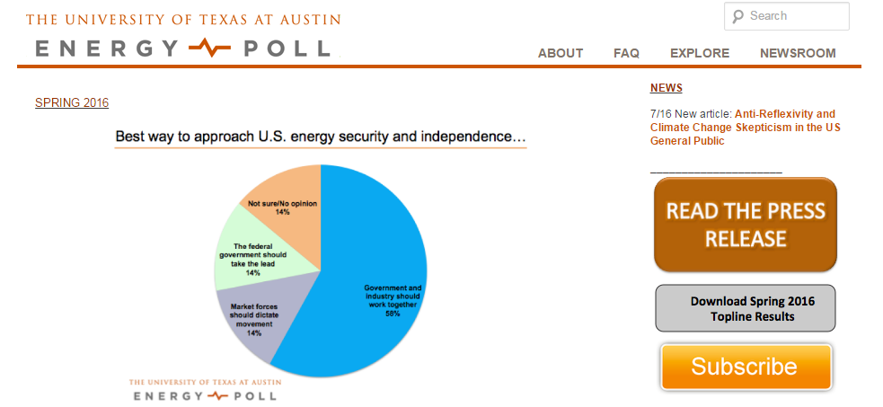
SEGMENTATION
Demographic Segmentation

Slide 20
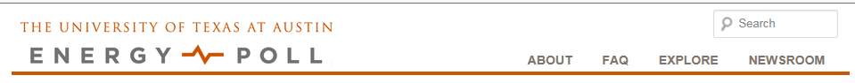
SEGMENTATION
Demographic Segmentation

Slide 21
SEGMENTATION
Demographic Segmentation

Slide 22
SEGMENTATION
Demographic Segmentation
Behavioral Intentions by Age

Slide 23
SEGMENTATION
Demographic Segmentation
Behavioral Intentions by Income

Slide 24
SEGMENTATION
Bases for Segmentation
WHY
Why do customers make the decisions they do?

Slide 25





SEGMENTATION
Service Satisfaction at a Credit Card Company

Slide 26
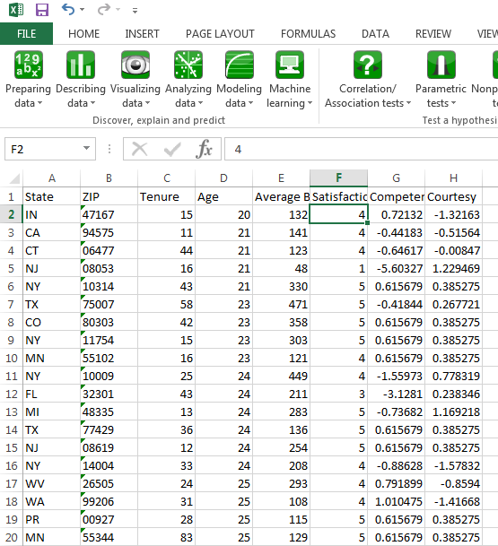
SEGMENTATION
Service Satisfaction at a Credit Card Company
Sample of 344 credit card customers
Customers rate their satisfaction with service representative
Customers also rate rep on competence and courtesy

Slide 27
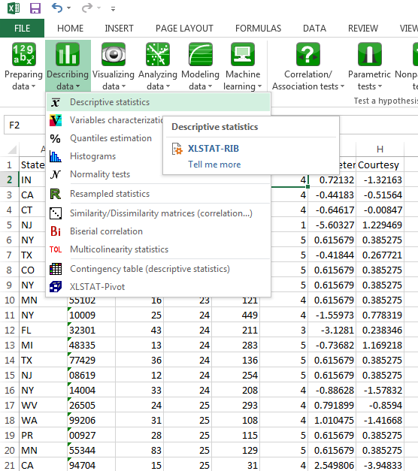
SEGMENTATION
Service Satisfaction at a Credit Card Company

Slide 28
SEGMENTATION
Service Satisfaction at a Credit Card Company

Slide 29
SEGMENTATION
Service Satisfaction at a Credit Card Company
What Drives Overall Satisfaction?
Competence
Satisfaction
Courtesy
What has the bigger impact on customer satisfaction?
Perceived Competence of the Service Rep?
Perceived Courtesy of the Service Rep?
Why would we care about this?

Slide 30
SEGMENTATION
Service Satisfaction at a Credit Card Company
Competence and Courtesy both matter
Competence more important than Courtesy
0.634
Competence
Satisfaction
0.436
Courtesy
But Does This Hold for All Consumers?

Slide 31
SEGMENTATION
Attitudinal Segmentation

Slide 32
SEGMENTATION
Attitudinal Segmentation
K-Means Cluster Analysis:
A Tool for Attitudinal Segmentation
We want to find groups of respondents that are
within-group similar on the competence and courtesy measures
across-group different on the competence and courtesy measures
K-Means cluster analysis is a tool to accomplish this goal
K refers to the number of segments/classes/clusters
Based on distances between respondents and the center of the segment
The center is called the “centroid” and is just the average (i.e., the mean) of the points within the segment
How does it work?

Slide 33
SEGMENTATION
K-Means Cluster Analysis: Example with 8 Data Points
Start by Choosing P Basis Variables
We have P=2 basis variables
Competence
Courtesy
Could have more than 2
EXAMPLE
Suppose I think there are 2 segments
How do I assign each data point to either segment 1 or segment 2?
If I knew the assignment, I could run segment specific analyses
Cluster analysis will identify which data point belongs to which segment.

Slide 34
SEGMENTATION
K-Means Cluster Analysis: Example with 8 Data Points
Start by Choosing P Basis Variables
We have P=2 basis variables
Competence
Courtesy
Could have more than 2
EXAMPLE
Suppose There are 2 Segments
To start the algorithm to find the segment membership for each point, computer randomly generates K=2 segment centroids and assigns each data point to its closest centroid

Slide 35
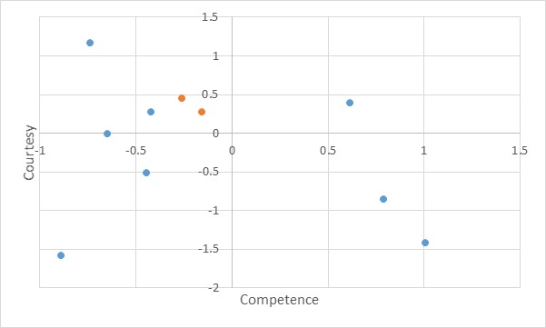
SEGMENTATION
K-Means Cluster Analysis: Example
computer generated centroid
data
Compute the squared distance between each data point and each centroid
Assign the data point to segment the with the closest center

Slide 36
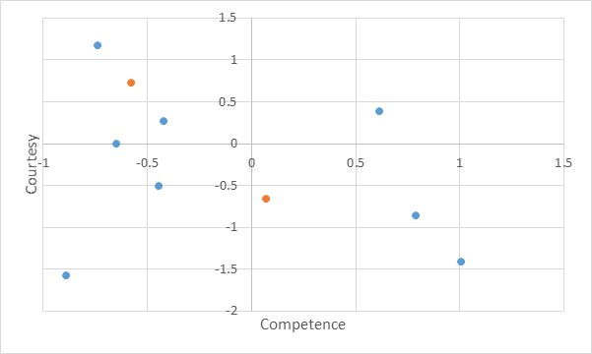
SEGMENTATION
K-Means Cluster Analysis: Example
Starting Point
After 1 Iteration
Data points are assigned to segments
New centroids are computed as segment average

Slide 37
SEGMENTATION
K-Means Cluster Analysis: Example
Now re-compute the squared distance between each point and new centroids
Re-assign the data point to segment with the closest center

Slide 38
SEGMENTATION
K-Means Cluster Analysis: Example
After 1 Iteration
After 2 Iterations
Notice the assignment of data points to segments changed

Slide 39
SEGMENTATION
K-Means Cluster Analysis: Example
After 4 Iterations
Best Solution for K=2
Solution for 2 Segments
The algorithm will stop when none of the data points can be assigned to a closer center point

Slide 40
SEGMENTATION
K-Means Cluster Analysis: Example
Now I can do any analysis I want by segment
But is 2 the right number of segments?

Slide 41
SEGMENTATION
K-Means Cluster Analysis: Example
How Do We Know the Correct Number of Segments (K)?
First Success Factor: Differentiable
Within a segment the variance in the basis variables is low
Across the segments the variance in the basis variables is high
EXAMPLE

Slide 42
SEGMENTATION
K-Means Cluster Analysis: Example
Choosing K for High Differentiability
EXAMPLE
In English
Result
Add up squared differences between each observation and the total mean
total variation
Add up squared differences between each observation and its group mean
within segment variation
Add up squared differences between each group mean and the total mean weighted by group sample size
between segment variation

Slide 43
SEGMENTATION
K-Means Cluster Analysis: Example
How Do We Know the Correct Number of Segments (K)?
First Success Factor: Differentiable
Inertia is a measure of differentiable
Inertia refers to the sum of squared distance from center (or average)
We can compute (or the computer can do it for us)…
Overall inertia
Within segment inertia
Between segment inertia
Within a segment we want the inertia in the basis variables to be low
Across the segments we want the inertia in the basis variables is high

Slide 44
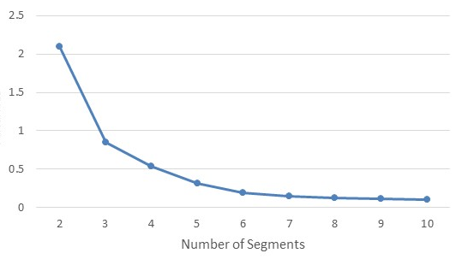
SEGMENTATION
K-Means Cluster Analysis: Example
A Heuristic to Choose K
Run algorithm for many values of K (k=1, 2, …, 6, 7, …)
Let computer compute inertia measures for each K
Plot the ratio of within-to-between group inertia
Ratio of Within to Between Inertia
EXAMPLE

Slide 45
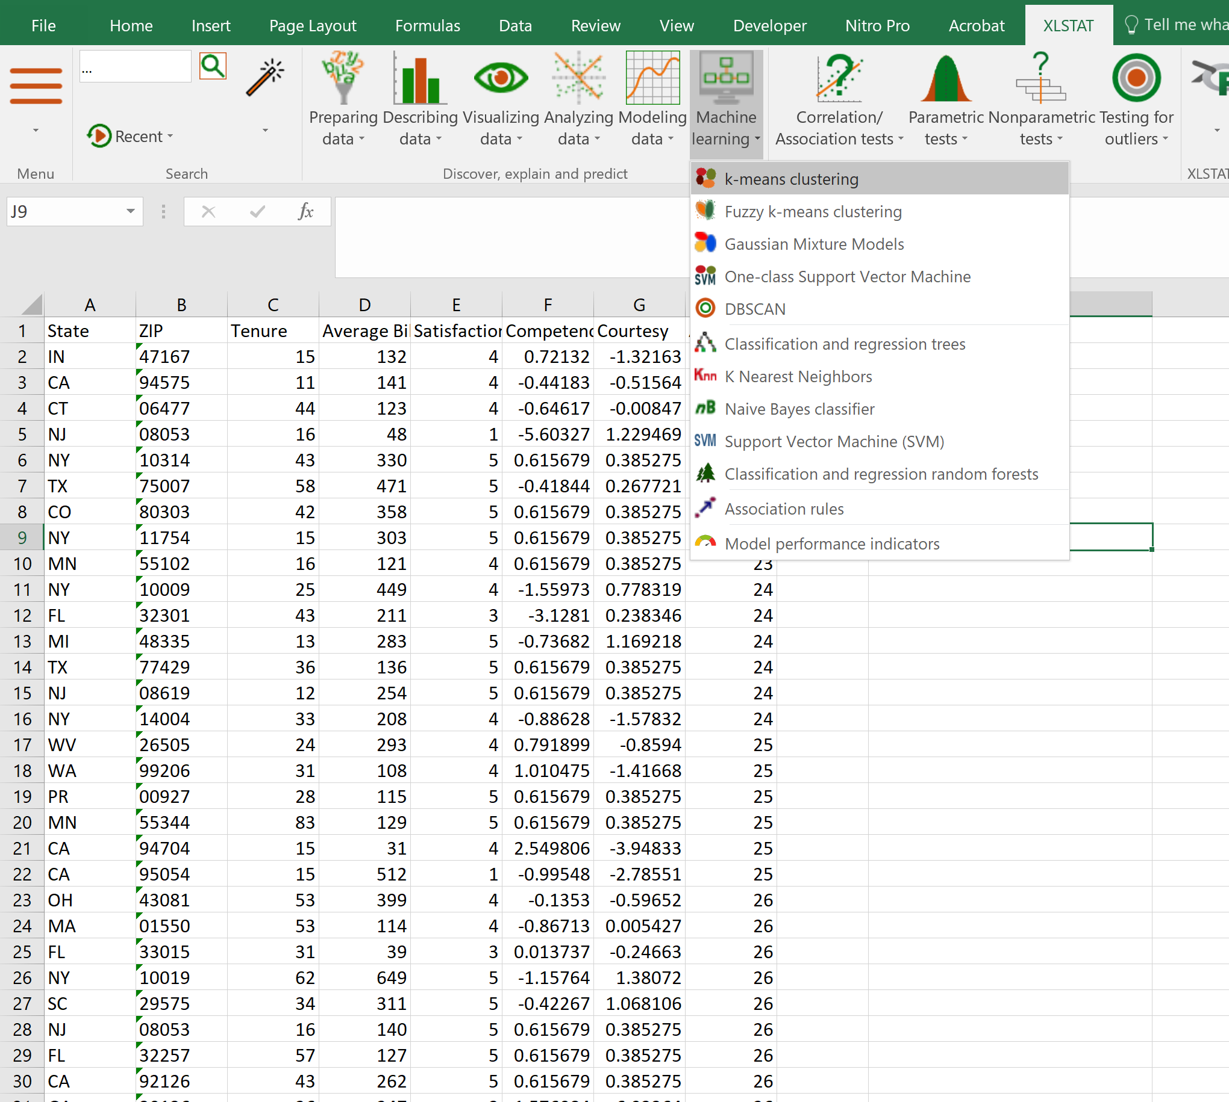
SEGMENTATION
K-Means Cluster Analysis: Example
How To Perform a K-Means Cluster Analysis in XLSTAT:
Run Model for Range of K Values

Slide 46
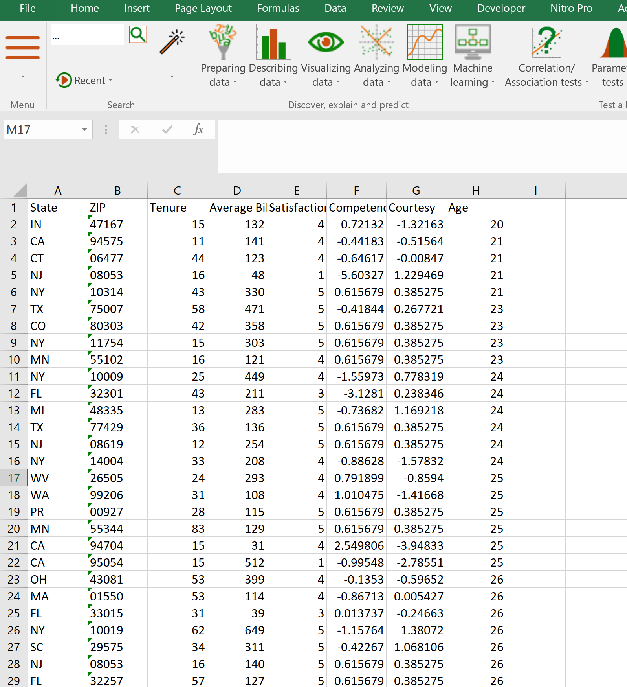
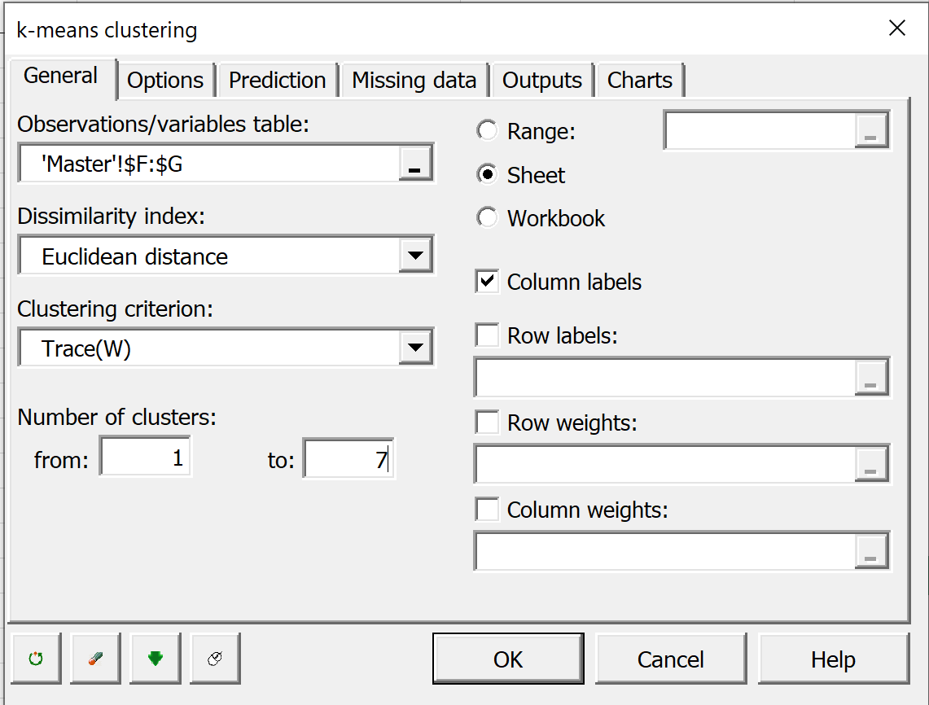
SEGMENTATION
K-Means Cluster Analysis: Example
How To Perform a K-Means Cluster Analysis in XLSTAT:
First Run Model for Range of K Values

Slide 47
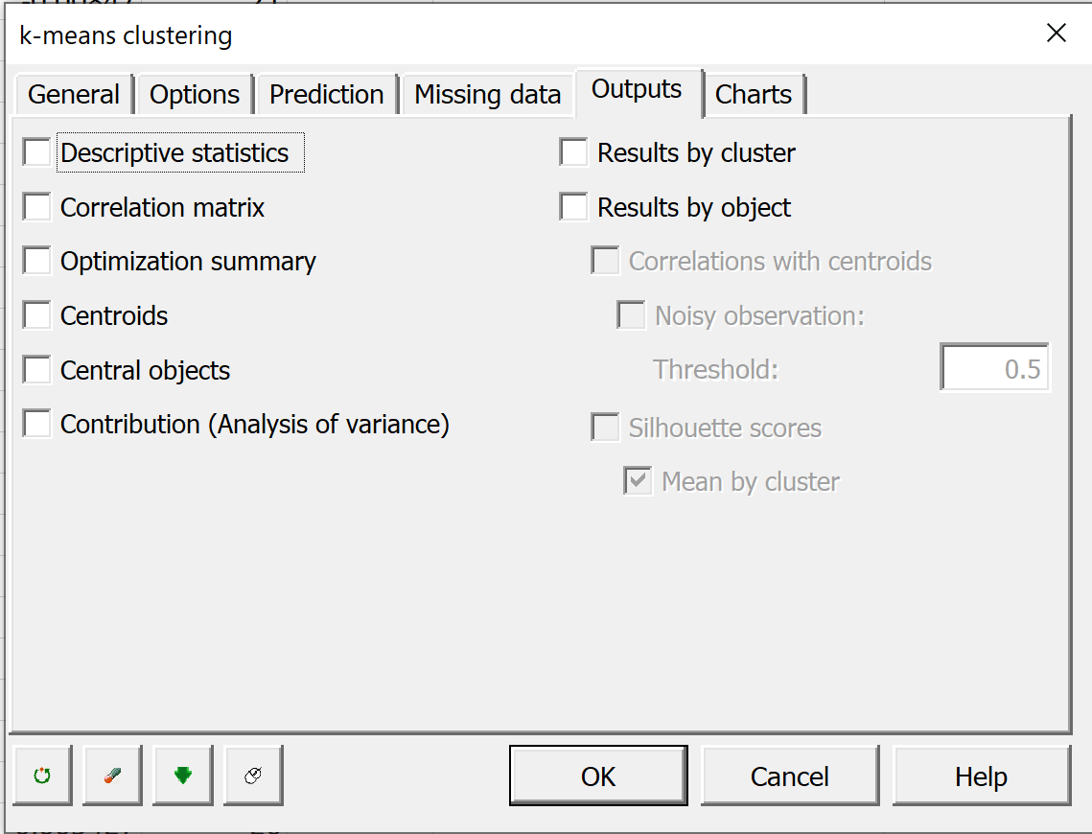
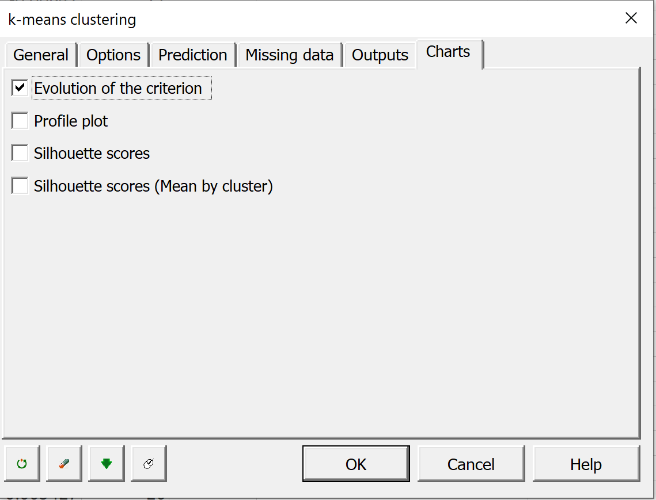
SEGMENTATION
K-Means Cluster Analysis: Example
How To Perform a K-Means Cluster Analysis in XLSTAT:
First Run Model for Range of K Values

Slide 48
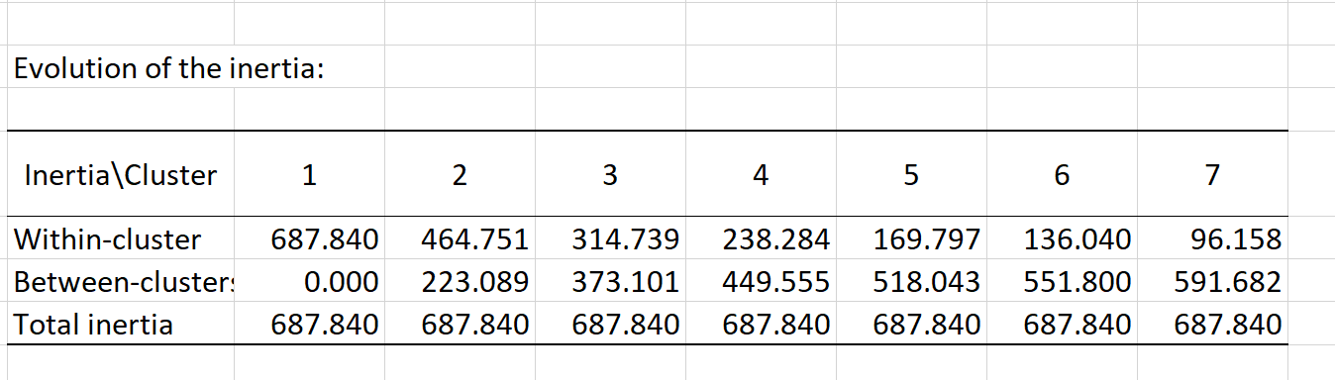
SEGMENTATION
K-Means Cluster Analysis: Example
How To Perform a K-Means Cluster Analysis in XLSTAT:
Examine the evolution of the inertia
Compute the ratio of the within to between cluster inertia

Slide 49
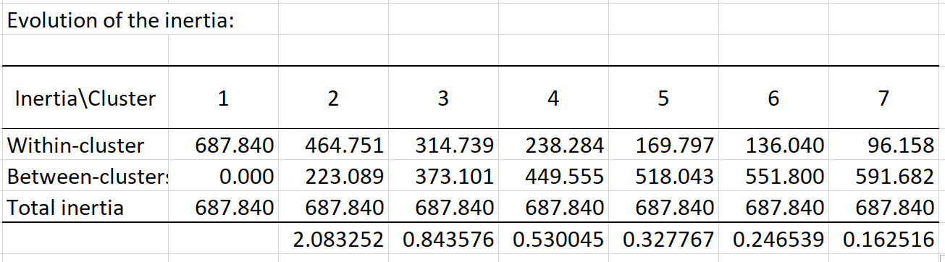
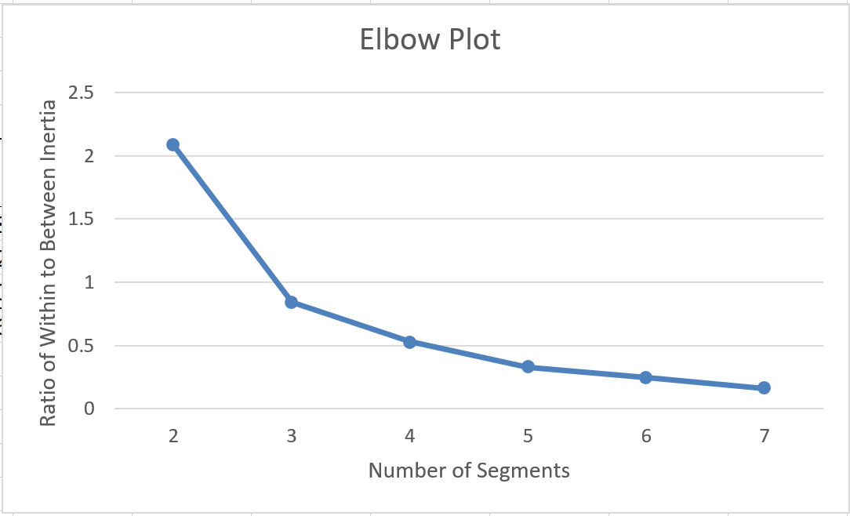
SEGMENTATION
K-Means Cluster Analysis: Example
Ratio of Within to Between Inertia

Slide 50
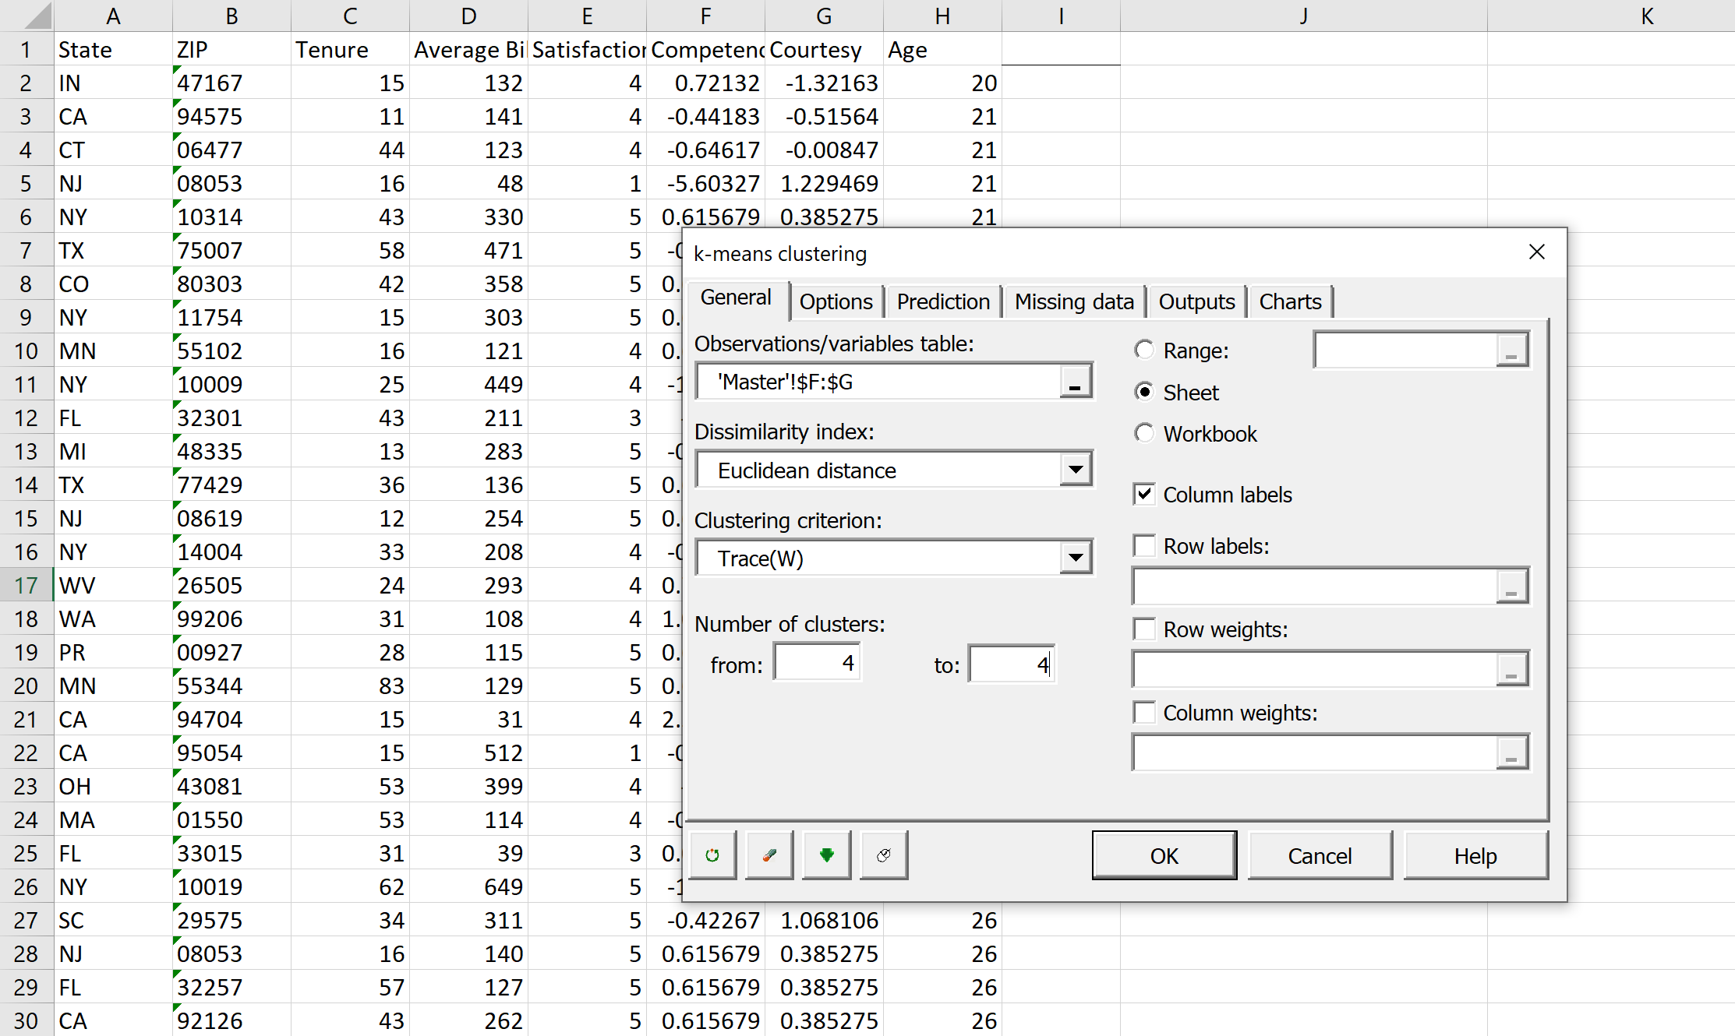
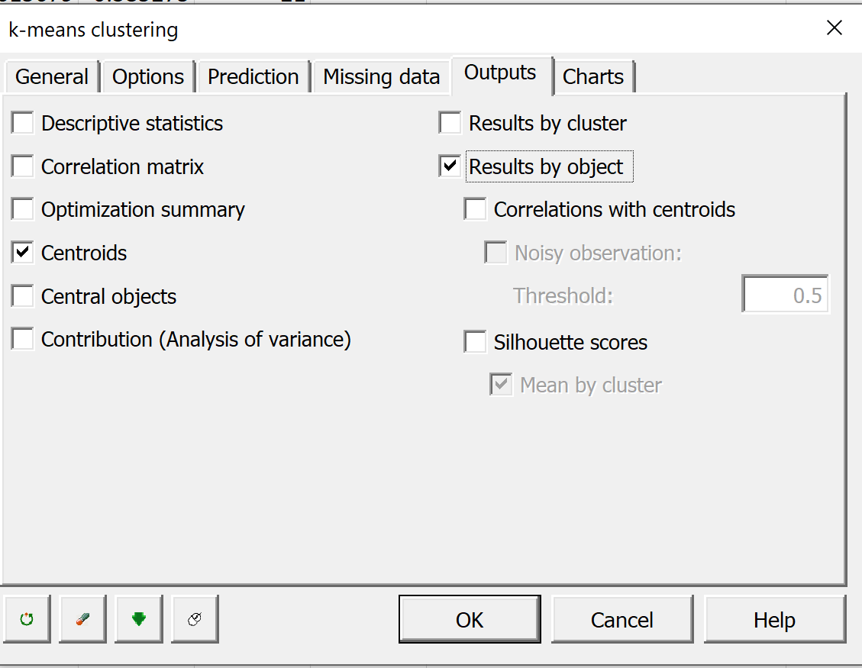
SEGMENTATION
K-Means Cluster Analysis: Example
How To Perform a K-Means Cluster Analysis in XLSTAT:
Re-Run for Chosen Number of Clusters (in our case 4)
You could examine 4 or 5 clusters (in the interest of time we will not)

Slide 51
SEGMENTATION
K-Means Cluster Analysis: Example
How To Perform a K-Means Cluster Analysis in XLSTAT:
Re-Run for Chosen Number of Clusters (in our case 4)
You could examine 4 or 5 clusters (in the interest of time we will not)
Four Segment Solution
These are the number of people in each Segment (respondents are all equally weighted here)
These are the average Competence and Courtesy scores for each of the four segments

Slide 52
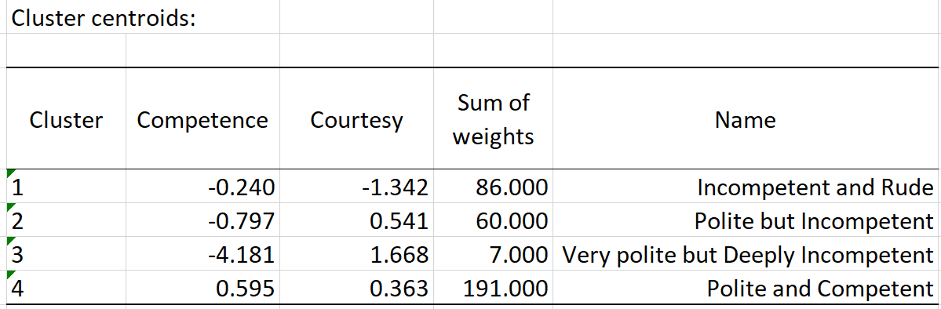
SEGMENTATION
K-Means Cluster Analysis: Example
Examine centroids
Name segments

Slide 53
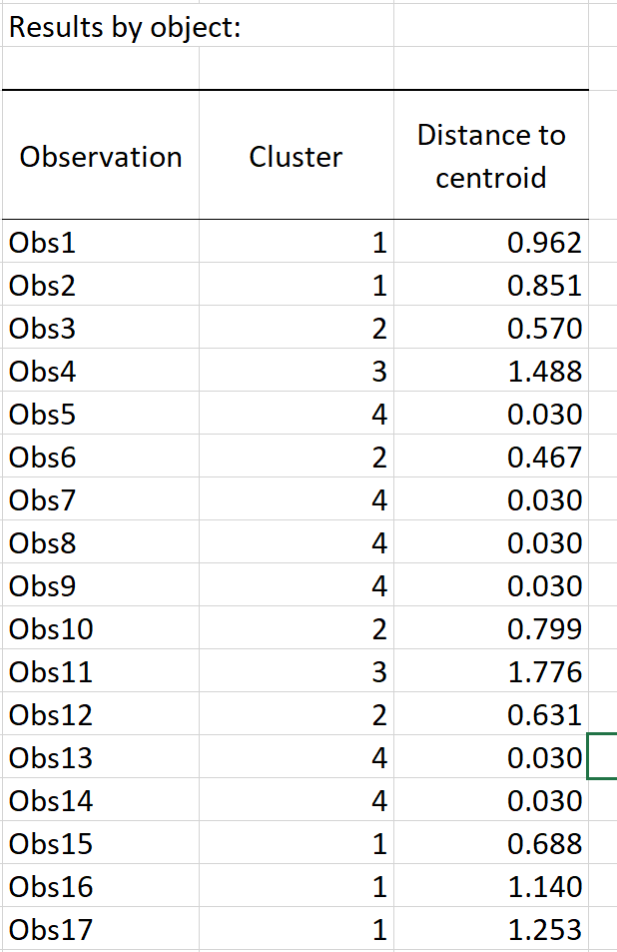
SEGMENTATION
K-Means Cluster Analysis: Example
Results by Object table is the label assigning each respondent to one of the four clusters

Slide 54
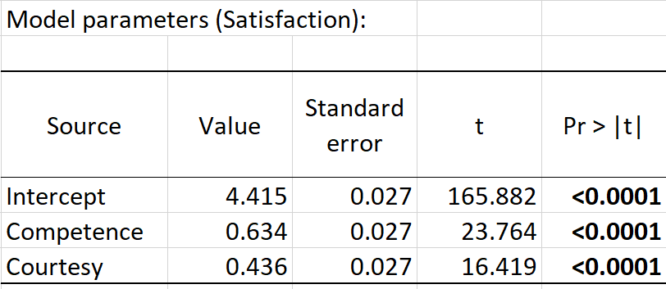
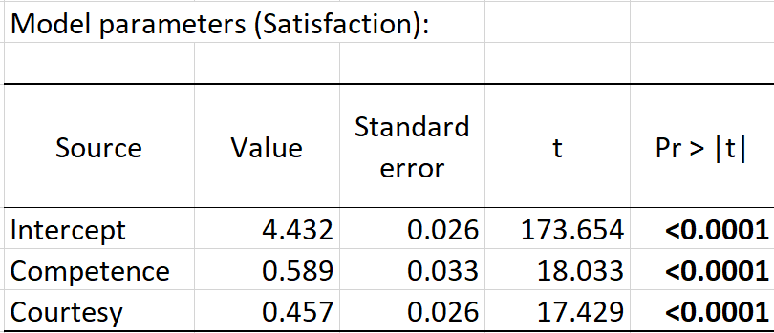
SEGMENTATION
K-Means Cluster Analysis: Example
All Respondents
7 Outliers in Segments 3 Removed
Does This Hold for All Consumers?

Slide 55
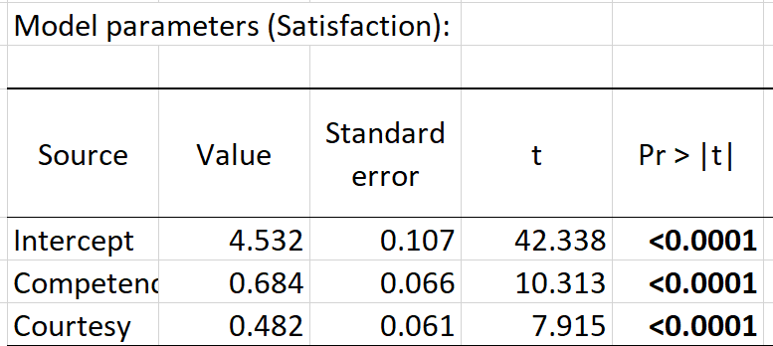
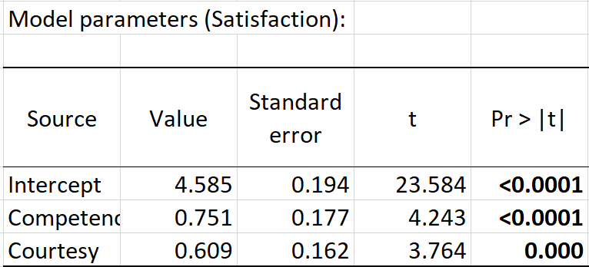
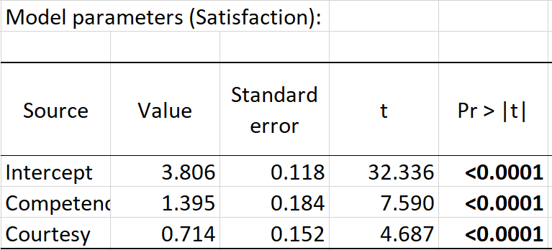
SEGMENTATION
K-Means Cluster Analysis: Example
Segment 1 Regression: Service Rep is Incompetent and Rude
Are there segment differences in the importance of competence and courtesy?
Segment 2 Regression: Service Rep is Nice Enough but Incompetent
Segment 4 Regression: Service Rep is Competent and Polite

Slide 56
SEGMENTATION
Segment 1 vs. Segment 2: Stack the Data
Segment 1 data
Segment 2 data

Slide 57
SEGMENTATION
Segment 1 vs. Segment 2
When Seg2=0
When Seg2=1
Consider the following hypotheses

Slide 58
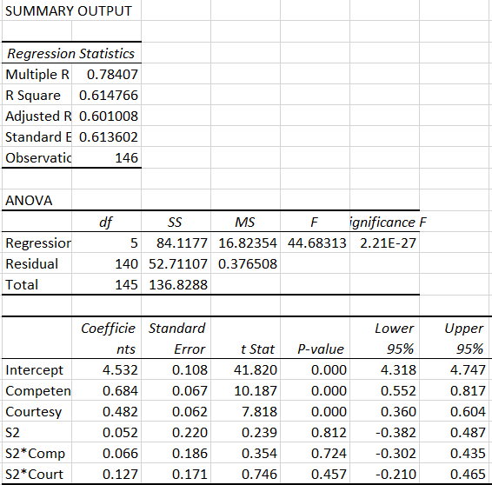
SEGMENTATION
Segment 1 vs. Segment 2

Slide 59
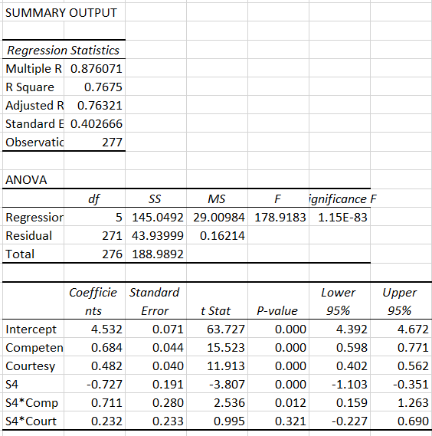
SEGMENTATION
Segment 1 vs. Segment 4

Slide 60
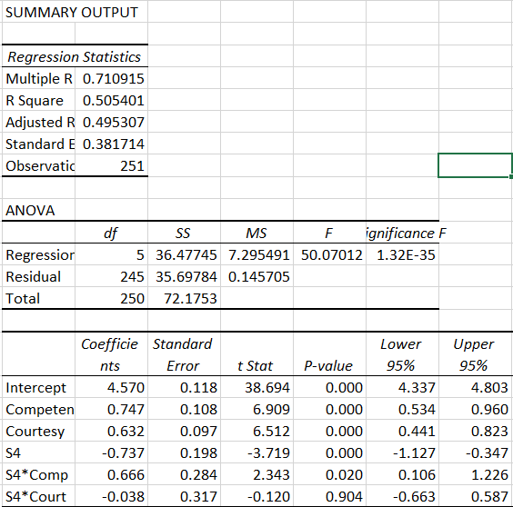
SEGMENTATION
Segment 2 vs. Segment 4

Slide 61
MARKETING ANALYTICS
Key Concepts for Today
Segmentation benefits firms and consumers
Success requires alignment on a number of factors
Can segment markets on different bases
K-Means cluster analysis is a tool useful for attitudinal segmentation
Finds segments that are within group homogeneous and between group heterogeneous on basis variables
Testing for group differences in a model

